Slide 1
Community Detection Within the Swiss Train Network
Mattias Dürrmeier, Christian Galley, and Olivia Lecomte
Notes:
MATTIAS

Slide 2
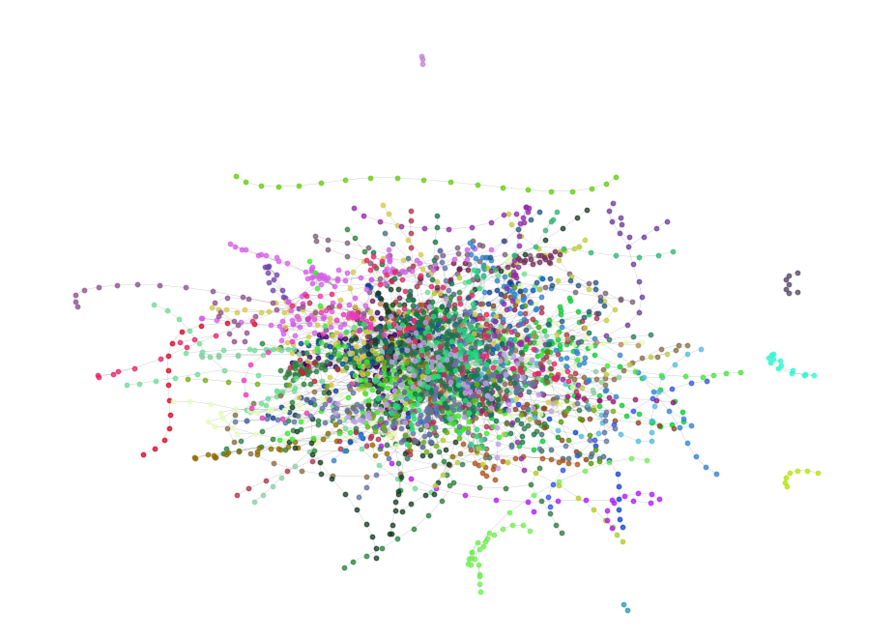
Table of Contents
Swiss Train Network Construction
Network Exploration and Visualization
Louvain and Leiden Overview
Benchmarks: Setup and Results
Notes:
MATTIAS

Slide 3
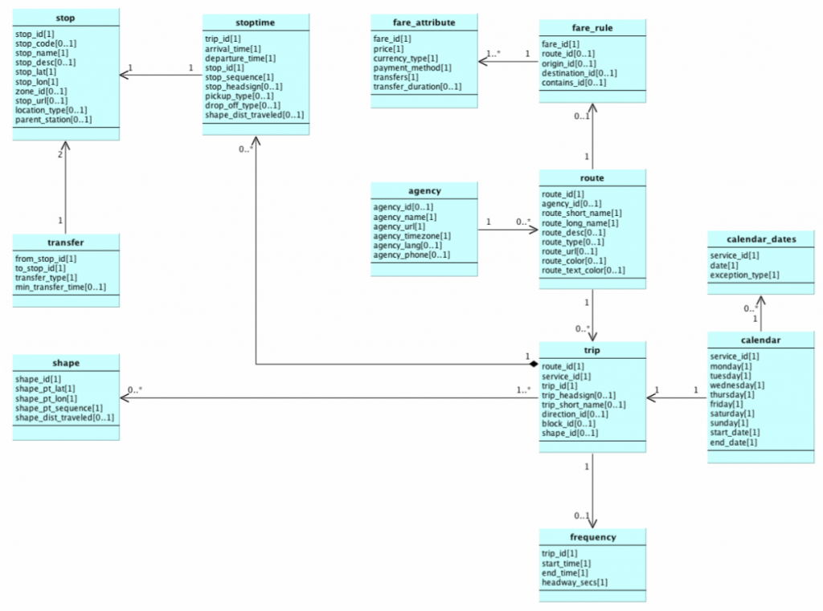
Network Source
SBB does not provide a complete network for this
Timetable 2024 from Open Data Platform Mobility Switzerland
Format: General Transit Feed Specification (GTFS)
Organized as relational tables
Open format for transportation schedules
Notes:
MATTIAS

Slide 4
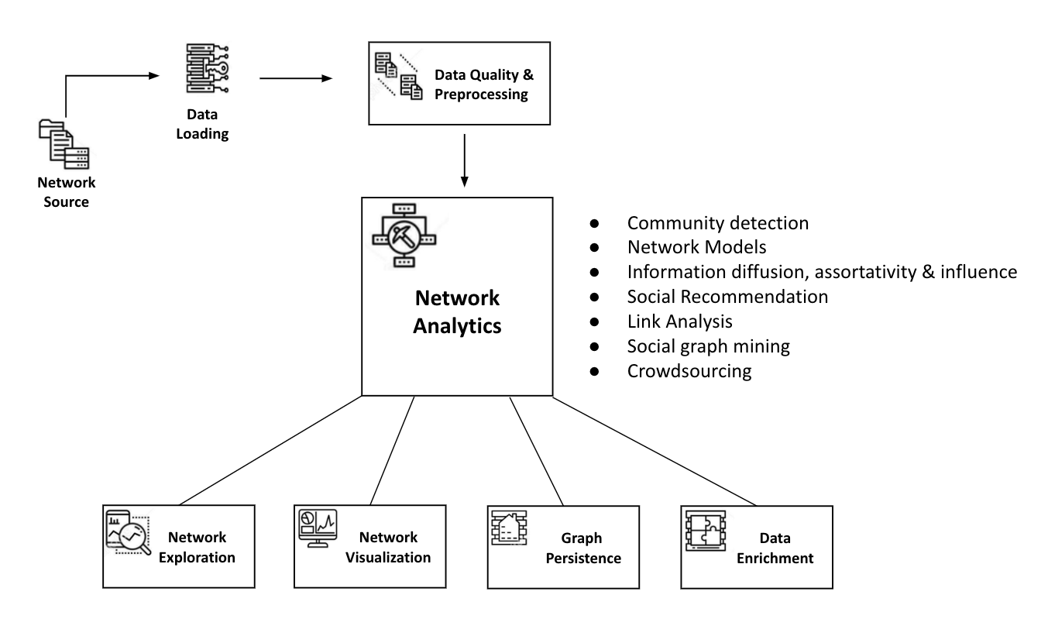
Network Construction
Loaded selection of GTFS data into Neo4j
Neo4j for preprocessing and persistence
Cypher queries to access data:
Station coordinates
Train network
Dataset is clean thanks to GTFS
Notes:
MATTIAS

Slide 5
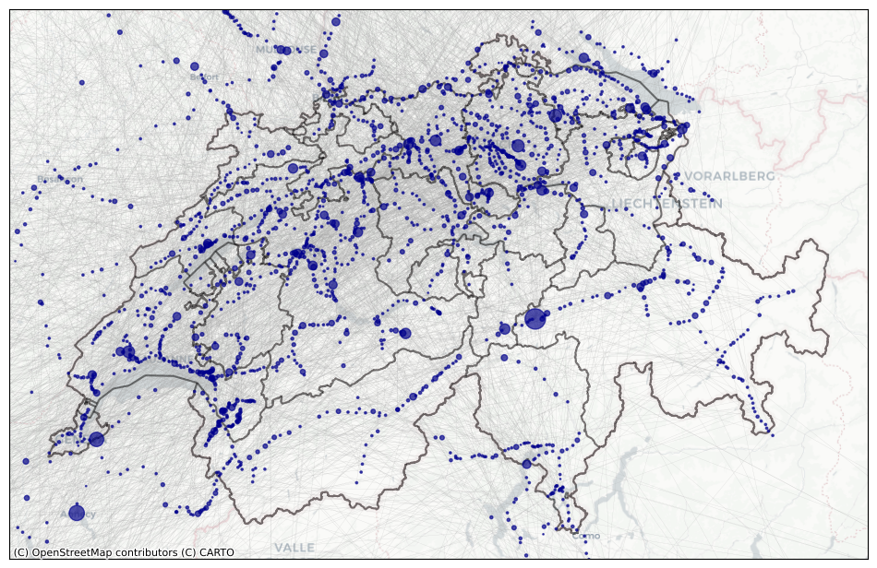
Network Exploration and Visualization
Number of nodes: 3152
Number of edges: 4678
Degrees: 1 – 40
Lyon Part Dieu, 40
Zürich HB, 36
123 stations, 1
Highest betweenness and closeness centrality: Zürich HB
Notes:
MATTIAS

Slide 6
Network Analysis
Community detection on largest connected component
Girvan Newman (NetworkX)
Louvain (NetworkX)
Louvain (Implemented)
Leiden (Reference)
Community detection analytics
Runtime per iteration
Clustering Quality: Silhouette Score
Notes:
CHRISTIAN

Slide 7
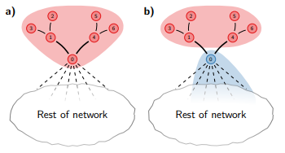
Louvain
Modularity gain as a quality function
May find badly connected communities
Possibly internally disconnected communities
[1]
Notes:
CHRISTIAN

Slide 8
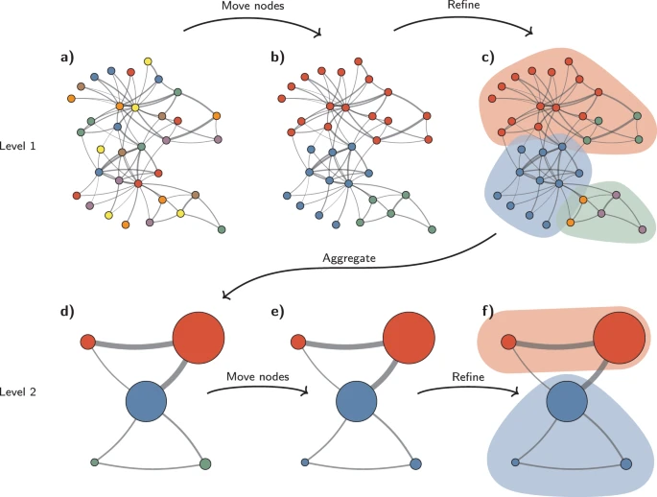
Leiden
Louvain improved
Guarantees well-connected communities
Typically faster
Main differences:
1) Efficient node-moving function
2) Refinement phase
[1]
Notes:
CHRISTIAN

Slide 9
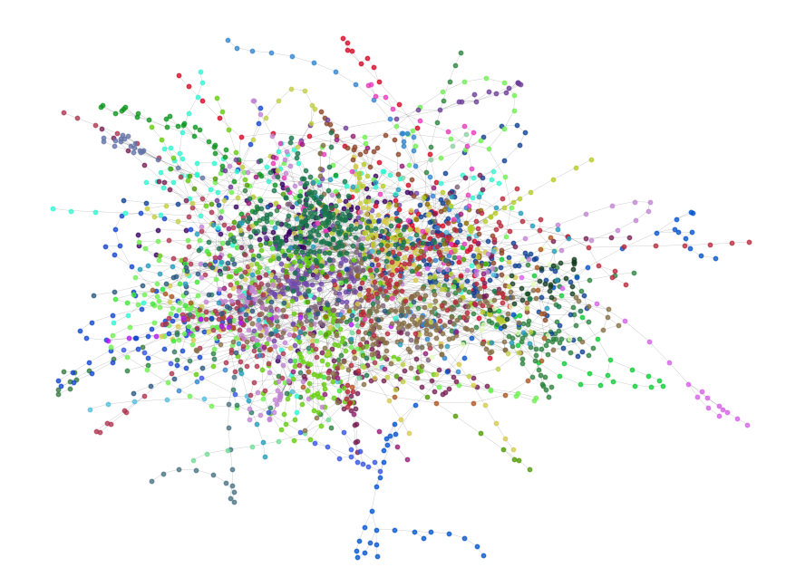
Benchmarking
Largest connected component
Average of 10 runs
Runtime in seconds
2 silhouette functions:
1) silhouette hops
2) silhouette coordinates
Run until convergence
Exception: Girvan Newman
Notes:
OLIVIA
- reminder: sil score > 0 means good clustering quality

Slide 10
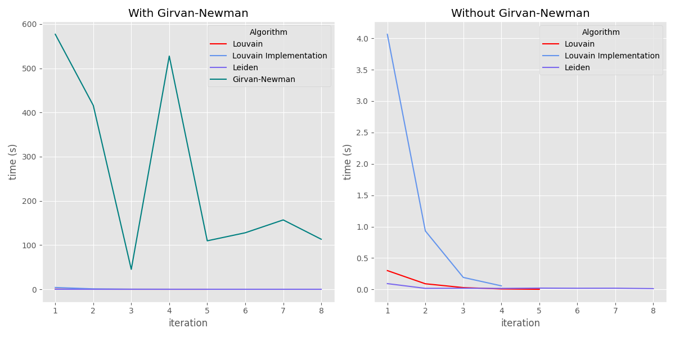
Runtime Performance
Notes:
OLIVIA

Slide 11
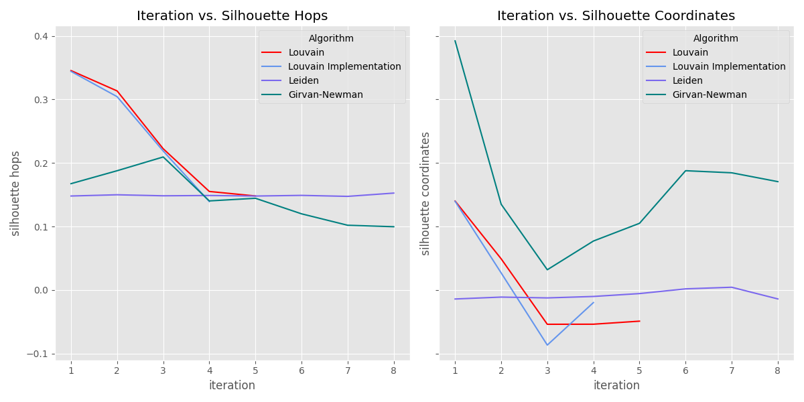
Clustering Quality
Notes:
OLIVIA

Slide 12
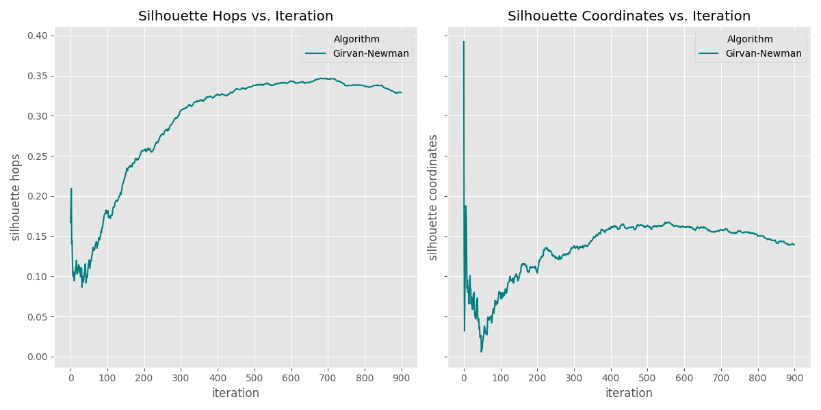
Progression of Quality for Girvan-Newman
Notes:
OLIVIA

Slide 13
Conclusion
Limitations
Future Work
Our implementation of Louvain is not optimized for performance
Improvements could be made to decrease runtime
Standard community detection algorithms are unable to cluster the transportation network
Based on graph structure alone
Investigate all forms of public transport in Switzerland
Expand network to include neighboring countries
Use more complex techniques such as Graph Neural Networks
Notes:
OLIVIA

Slide 14
Thank you! Any questions?
Notes:
OLIVIA

Slide 15
References
[1] V. A. Traag, L. Waltman, and N. J. Van Eck, "From Louvain to Leiden: guaranteeing well-connected communities," Scientific Reports, vol. 9, no. 1, p. 5233, 2019.

